Slide 1

Questions
Group 670

Slide 2

CONTENT
GENERAL GUIDELINES
STUDENTS
PBL
RESEARCH AND RANKING
BUSINESS COLLABORATION
STRATEGY 2016-21

Slide 3
Another MPPT algorithm: Constant voltage
Pro:
Using only a voltage sensor
A simple loop for control
Contra:
The method can’t handle a change in environmental condition (temperature, partial shading)
Notes:
with strong temperature fluctuation the assumption of linear dependence is no longer valid
For a partial shaded PV panel the P-V curve has got multiple local maxima and the method can‘t handle this

Slide 4
Another MPPT algorithm: Fuzzy logic control
Pro:
inputs can be imprecise
not needing an accurate mathematical model
handling nonlinearity
performing well under varying environmental condition
Contra:
The method can’t handle a change in environmental condition (temperature, partial shading)
Notes:
with strong temperature fluctuation the assumption of linear dependence is no longer valid
For a partial shaded PV panel the P-V curve has got multiple local maxima and the method can‘t handle this

Slide 5
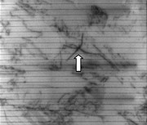
Why bidirectional ?
Extracting and injecting current from the PV panel
Injection current:
Because of electroluminescence
the PV panel emits light for
detection microcracks
Microcracks:
The orientation is important for
causing power losses.
The most critical one is parallel to the
busbars.
Electroluminescence image of a PV panel [1]
[1] https://www.sensovation.com/com/Applications/Photovoltaic

Slide 6
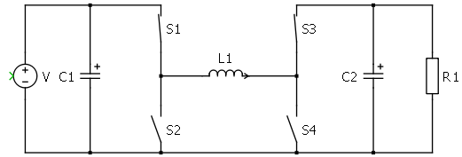
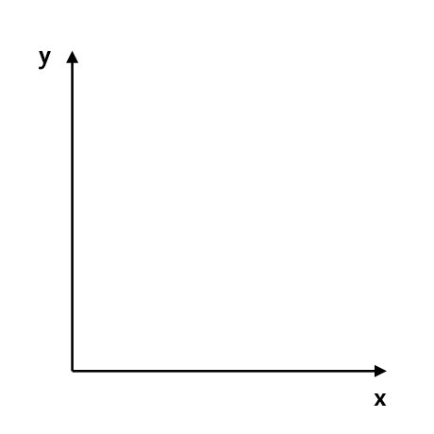


DCM
MOSFETs do not prevent reverse current like a diode would.
DCM mode is never reached when working with the 4 transistors.
Instead current would be negative through the couil.
$$I_{L}$$
$$t$$

Slide 7
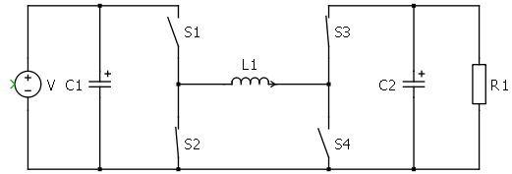
DCM
MOSFETs do not prevent reverse current like a diode would.
DCM mode is never reached when working with the 4 transistors.
Instead current would be negative through the couil.
$$I_{L}$$
$$t$$

Slide 8
DCM
MOSFETs do not prevent reverse current like a diode would.
DCM mode is never reached when working with the 4 transistors.
Instead current would be negative through the couil.
$$I_{L}$$
$$t$$

Slide 9
DCM
MOSFETs do not prevent reverse current like a diode would.
DCM mode is never reached when working with the 4 transistors.
Instead current would be negative through the couil.
$$I_{L}$$
$$t$$

Slide 10
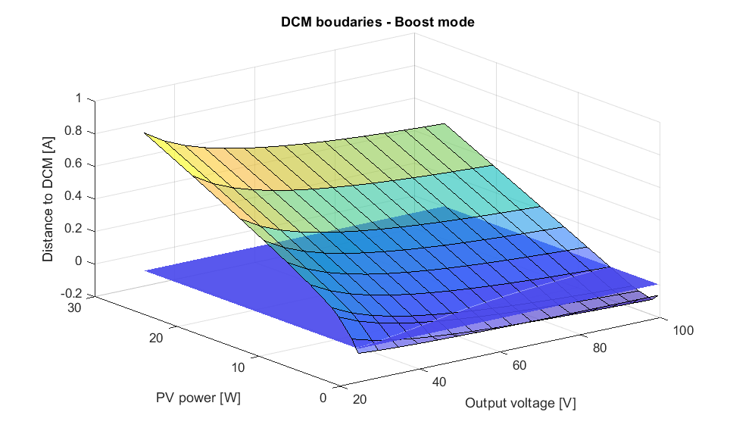
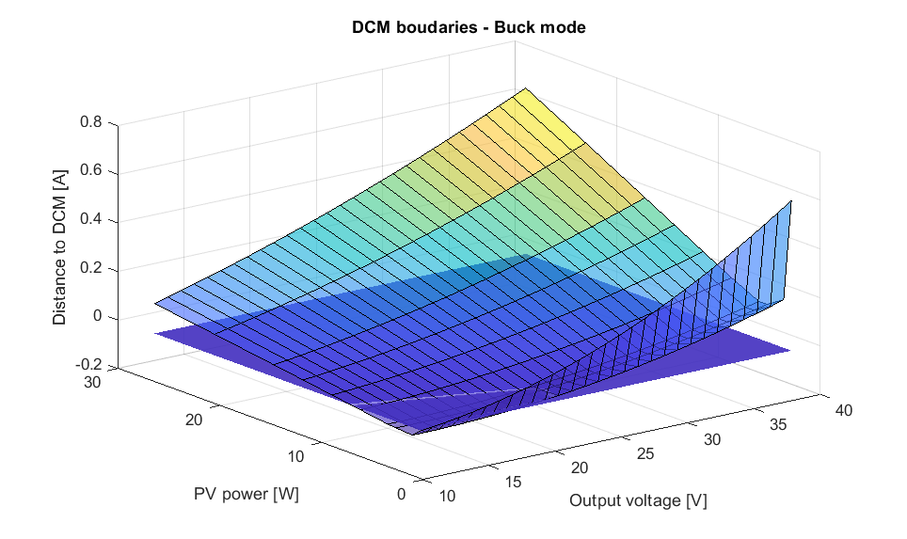
DCM
DCM mode depends on output voltage and power generated.

Slide 11
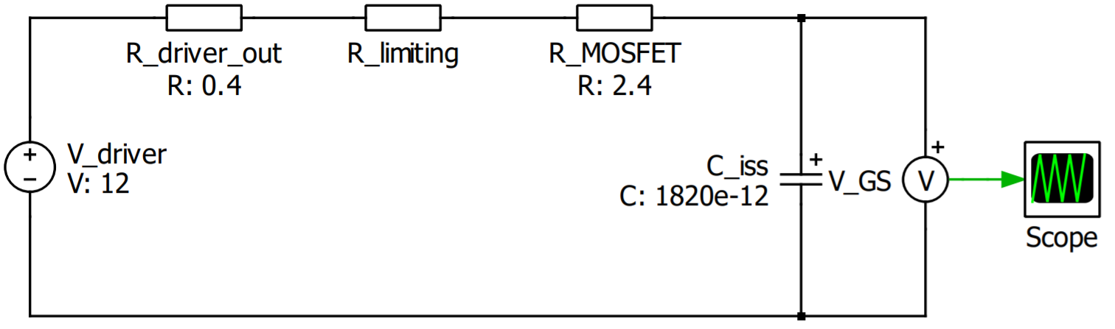

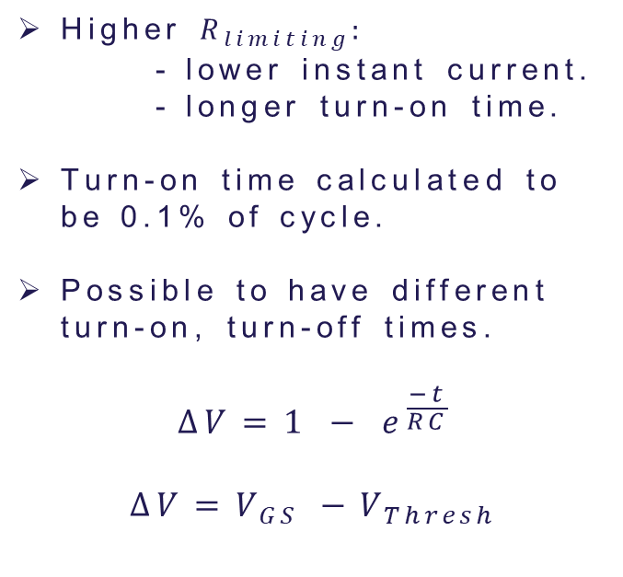
Limiting resistance
OUT H
$$R_{limiting}$$
Higher $R_{limiting}:$
- lower instant current.
- longer turn-on time.
Turn-on time calculated to be 0.1% of cycle.
Possible to have different turn-on, turn-off times.
$$∆V=1 − e^{\frac{−t}{RC}}$$
$$∆V=V_{GS} −V_{Thresh}$$
PWM
DRV
OUT L

Slide 12


Discharging resistance
Higher $R_{limiting}:$
- lower instant current.
- longer turn-on time.
Turn-on time calculated to be 0.1% of cycle.
Possible to have different turn-on, turn-off times.
$$∆V=1 − e^{\frac{−t}{RC}}$$
$$∆V=V_{GS} −V_{Thresh}$$
$$R_{discharge}$$
$$C_{iss}$$

